Slide 1
Video Game Asset Creation Pipeline
-
2D to 3D Conversion Progress Demo
Alex Banning

Slide 2
Review of High-Level Goals
Want to create an easier asset creation pipeline for solo and small team game devs (i.e. myself)
Interested in learning how Adobe Projects Turntable & Neo work
Apply the same/a similar pipeline (2D to 3D conversion) for game assets in Unity

Slide 3
Schedule Review
(Slightly Modified from Last Time)
Week 1: Research Stage (Wrapping Up)
Research and test Adobe app
Research related 2D -> 3D topics
Week 2: Consolidate Findings & App Development (Upcoming)
Create app design artifacts
System diagrams
Basic UI mockups
Deliverables:
MVP: Lightweight app demo of 2D -> 3D conversion in Unity
Upload SVG within Unity
Create a mesh from rotational sweep or extrusion
Possibly allow for custom mesh edits in the preview window
Toolbox: Faster asset creation pipeline solutions for the solo game dev.
Lay foundation for exploring this topic further, possibly as a thesis

Slide 4
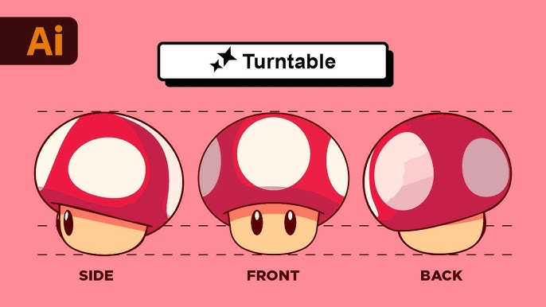
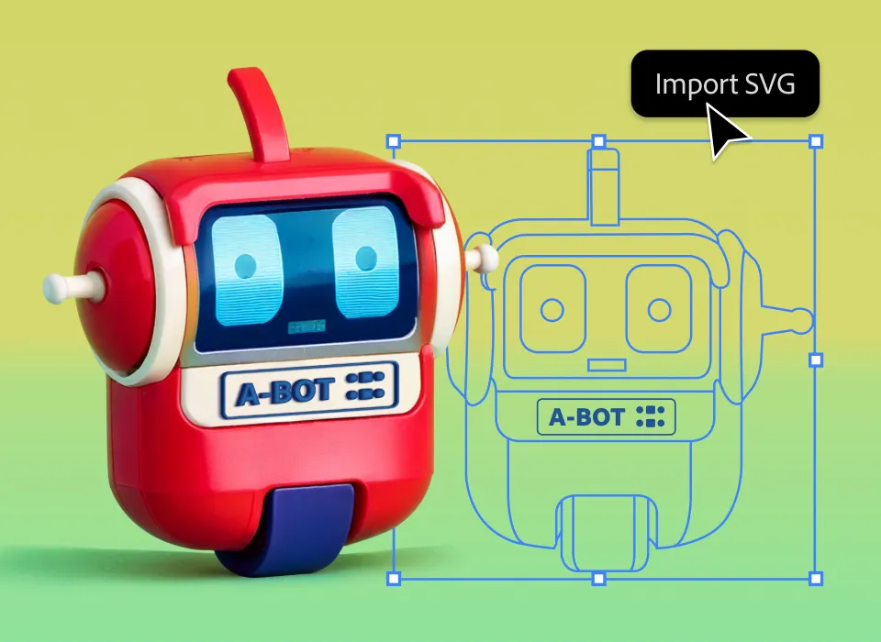
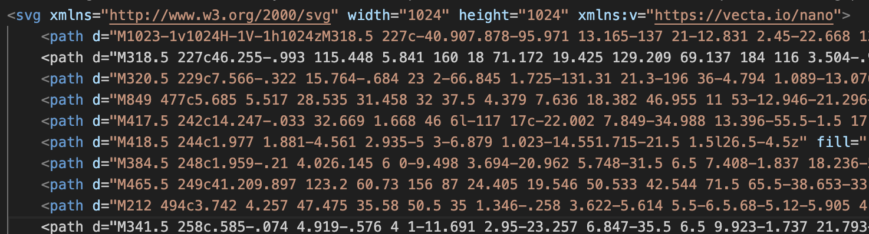
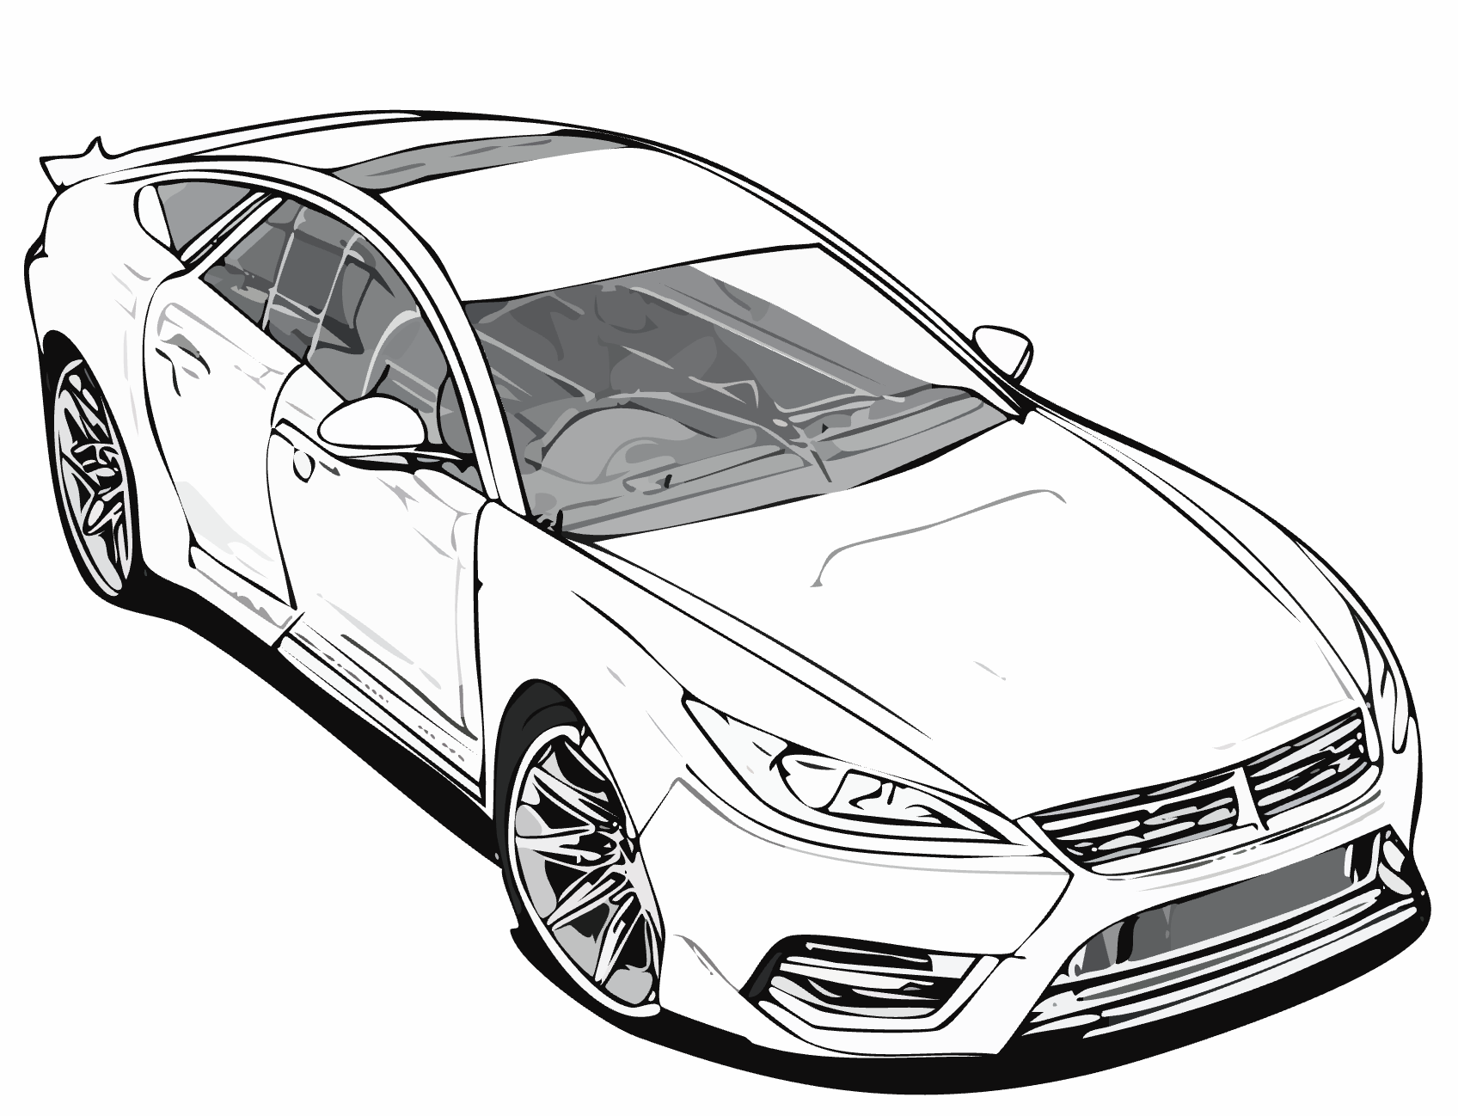
What Have I Learned So Far?

Slide 5
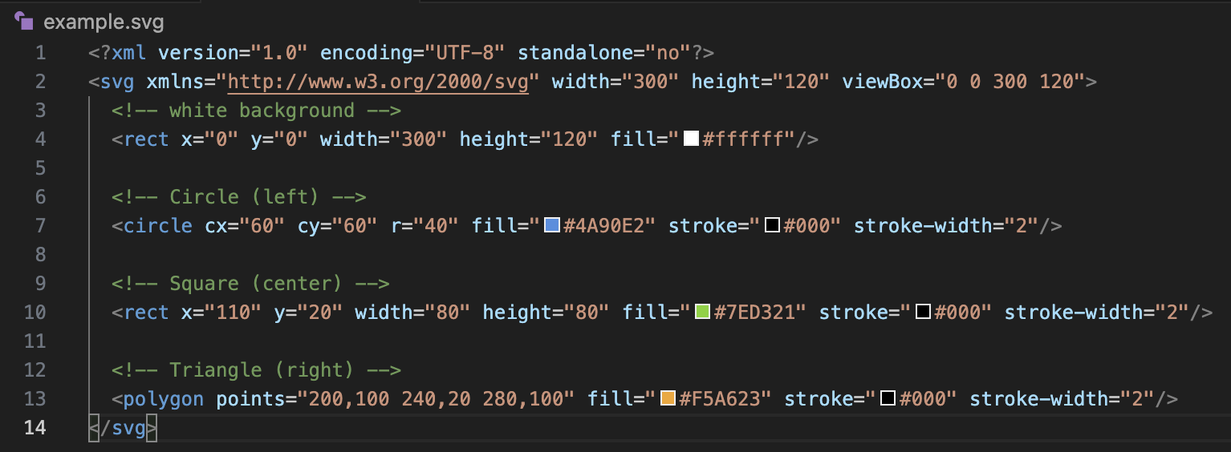
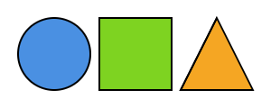
What is SVG? [5]
Scalable Vector Graphics files are XML-based representations of geometry
Describe mathematics to “draw” the desired image using commands
Resolution independent - scales cleanly at higher resolutions
Contrasts with raster graphics (i.e. png, jpg, gif) - become pixelated when scaled up

Slide 6
How Adobe’s Turntable Works [2] [3] [6] [7]
Input: SVG file (standard illustrator 2D vector file)
Max size: 100KB
Uses Adobe Firefly (AI) to generate many views
240 degree range
Each slider position = an entire SVG file
Each SVG view is exportable
Not actually creating a 3D geometry just showing different SVG angles

Slide 7
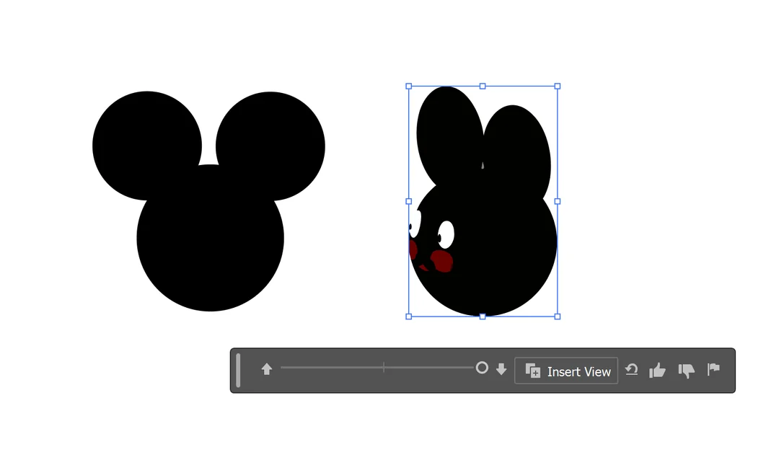
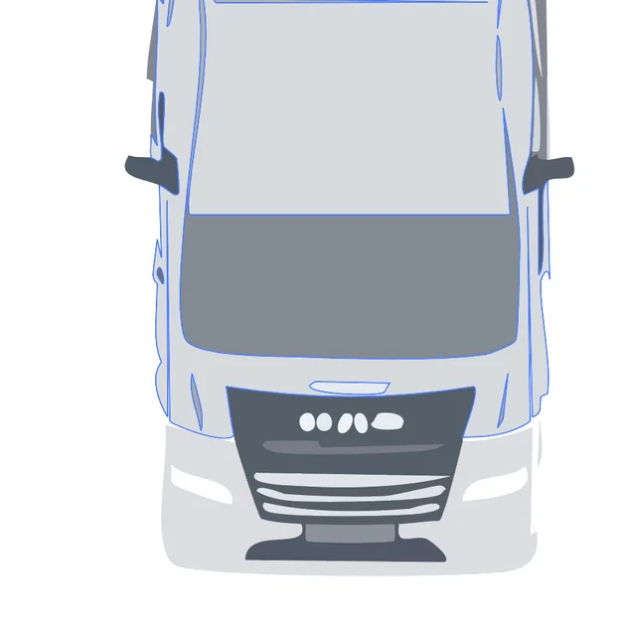
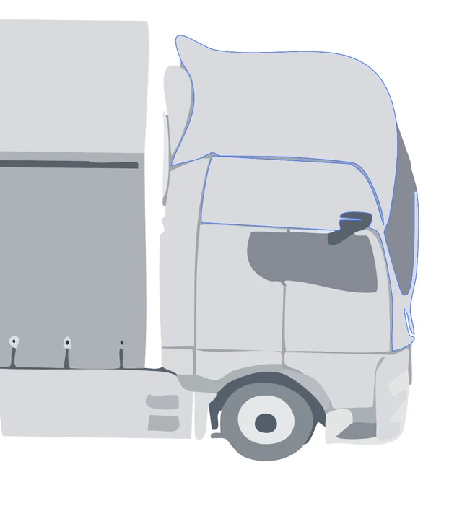
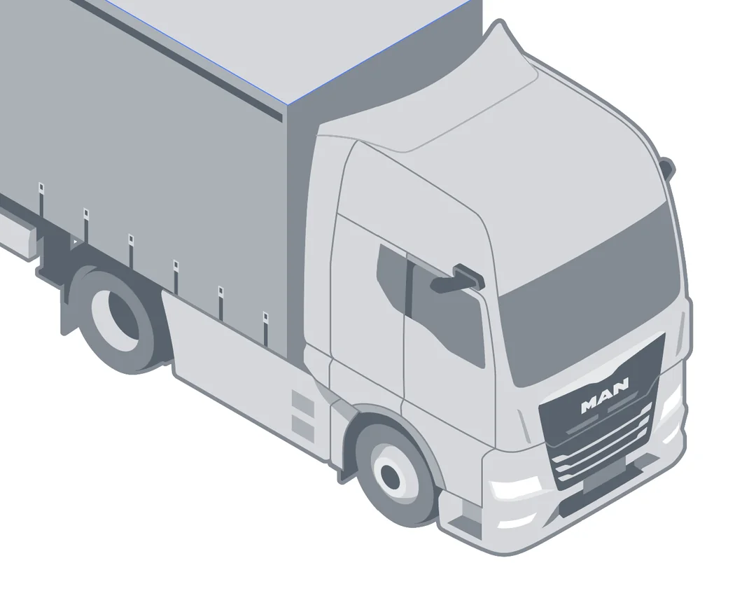
Limitations of Turntable [7]
Cannot handle more detailed work
Messes up isometric drawings
Trained on open source artwork
Limits the variance in output (smaller sample size)
Uses AI to interpret what it doesn’t know

Slide 8
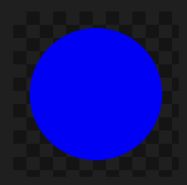
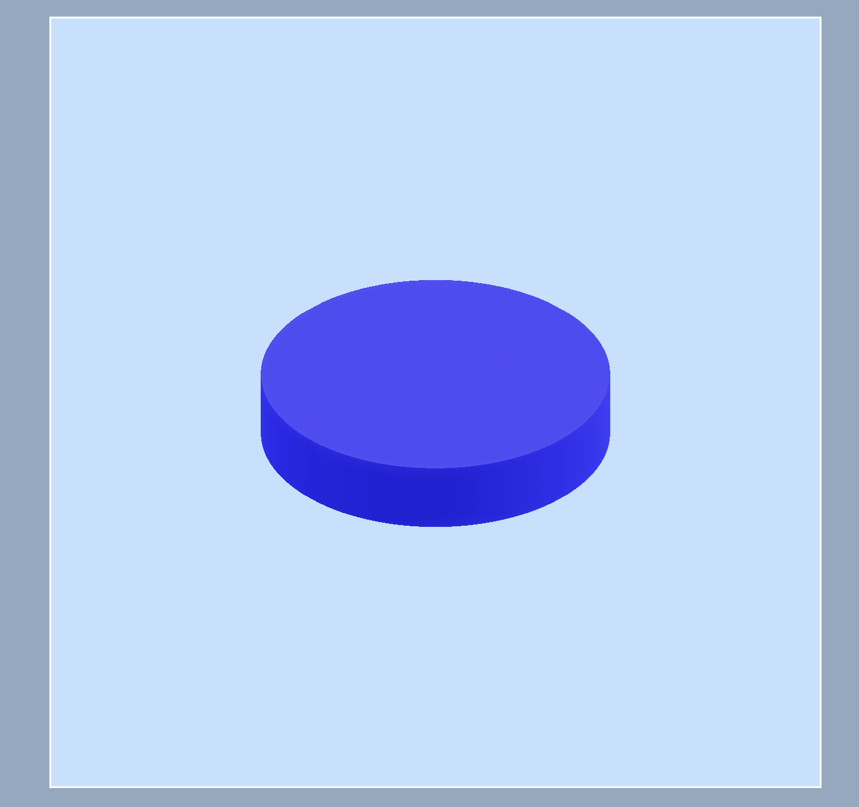
How Project Neo (Beta) Works [4] [6] [8]
Expands on the functionality provided by Turntable
Can render 3D geometries from 2D input (SVG) AND vice versa
Important caveat: Cannot import 3D files -> must be made in Project Neo
CAN export SVG and many other file types

Slide 9
Limitations of Project Neo (Beta) [6]
Lack of support for shape editing
Rigid gizmo controls only allow certain flexibility
Only supports most common raster and vector graphics imports (png, jpg, SVG)
Vectorization feature (raster to vector graphics 2D) is finicky at best
ALWAYS extrudes the shape
SVG represents a 2D “slice” that is vertically extruded by some arbitrary height the user can manipulate
Doesn’t create anything smooth unless specifically defined after
Really….. REALLY slow when projects get big
Even one complex SVG file causes lag in the UI

Slide 10
Other 2D -> 3D Conversion Findings [1]
Paper: “A visibility algorithm for converting 3D meshes into editable 2D vector graphics”
This is the exact OPPOSITE pipeline I want to create
Basic Process:
Project the mesh to 2D space
Determine, in a smart way, where to make cuts (to create layers)
Identifying cycles in their algorithm
Remove the cut layer
Rinse and repeat
What This Tells Us:
Information is lost when flattening a mesh into 2D
To reconstruct 3D mesh from 2D vectors, we need to get that information back
Construct layer-by-layer
Determine, in a smart way, how to fuse cuts (reconnect layers)
Bend mesh correctly where layers reconnect

Slide 11
Where Do We Go From Here?
Correctly rebuilding complex meshes from 2D drawings is an entire thesis topic
Going to simplify my app design
Import SVG
Copy extrusion from Project Neo and other tools like Blender
Allow user to redefine the geometry to customize extrusion like in Project Neo but before generating the mesh
Present my findings in a paper as a toolbox for solo game devs
What options exist for small game developers in asset creation?
How can they be used? What are their limitations? How to problem solve common issues?
Lay foundation for a thesis topic in robust 2D -> 3D reconstruction

Slide 12
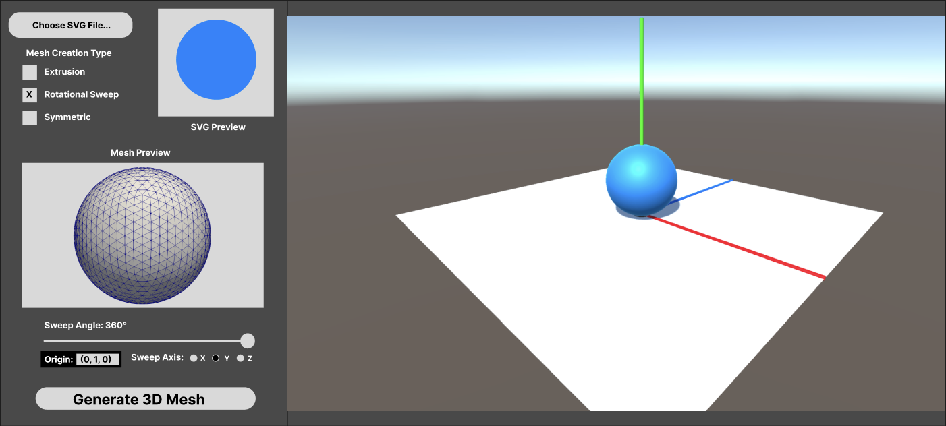
Mockup of New Idea

Slide 13
References
3D -> 2D paper
[1] E. Eisemann, S. Paris, and F. Durand, “A visibility algorithm for converting 3D meshes into editable 2D vector graphics,” ACM SIGGRAPH 2009 papers, pp. 1–8, Jul. 2009, doi: https://doi.org/10.1145/1576246.1531389.
Adobe Official Pages
[2] “View 2D objects from new angles,” Adobe.com, 2019. https://helpx.adobe.com/illustrator/desktop/use-generative-ai/view-artwork-from-any-angle.html (accessed Dec. 01, 2025).
[3] “Project Turntable,” Adobe Research, 2020. https://research.adobe.com/video/project-turntable/ (accessed Dec. 01, 2025).
[4] “Project Neo (Beta) overview,” Adobe.com, 2019. https://helpx.adobe.com/project-neo/help/overview.html (accessed Dec. 01, 2025).
SVG Documentation
[5] “SVG Tutorial,” www.w3schools.com. https://www.w3schools.com/graphics/svg_intro.asp
Analysis on the Capabilities of Adobe Firefly
[6] “View of The capabilities of the art-oriented artificial intelligence Adobe Firefly and its visual advantages and disadvantages | Journal ‘Fundamental Sciences and Applications,’” Tu-plovdiv.bg, 2024. https://journals.tu-plovdiv.bg/index.php/journal/article/view/868/54
Reddit Post
[7] “Reddit - The heart of the internet,” Reddit.com, 2024. https://www.reddit.com/r/AdobeIllustrator/comments/1mtxoy9/turntable_feature_a_quick_overview/ (accessed Dec. 01, 2025).
Video Review of Turntable and Neo (YouTube)
[8] Victoria White, “Adobe Illustrator Beta: New Turntable Feature Explained!,” YouTube, Aug. 20, 2025. https://www.youtube.com/watch?v=meMpXA9gEQg (accessed Dec. 01, 2025).

Slide 14
Thank you!
Questions?

